Slide 1

TETRA Low-Code Workshop Node-RED
13 juni 2024

Slide 2
Te installeren
Docker + docker compose https://docs.docker.com/get-docker/
On-Premises data gateway (Enkel voor Power Apps) https://learn.microsoft.com/en-us/data-integration/gateway/service-gateway-install
Docker bestanden te vinden via: https://github.com/u0118137/noderedworkshop
git clone https://github.com/u0118137/noderedworkshop.git

Slide 3









Omgeving
node-red
1880
mosquitto
Ssid: Linksys01008
Pw: lowcodeworkshop
Ip range: 192.168.63.0/24
1883
mysql
3306
grafana
Mqtt server
Ip: 192.168.63.101
3000
Factory IO
OPCUA
Hostname:
opc.tcp://N-NB108284:4334/UA/myFactory

Slide 4
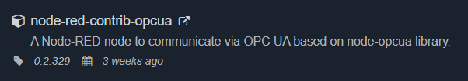
OPC UA in Node-RED

Slide 5
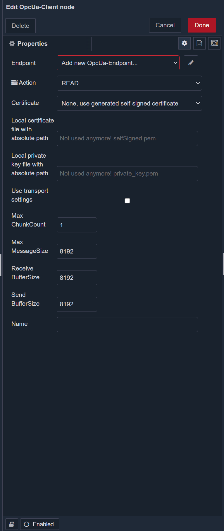
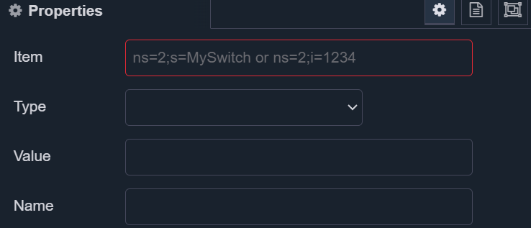

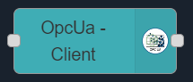
OPC UA Overview
Notes:
Item: zet de data van een specifieke variabele in juist formaat Client: zet een connectie op met de server (LET OP: elk client blokje is zijn eigen verbinding met de server -> Load)

Slide 6
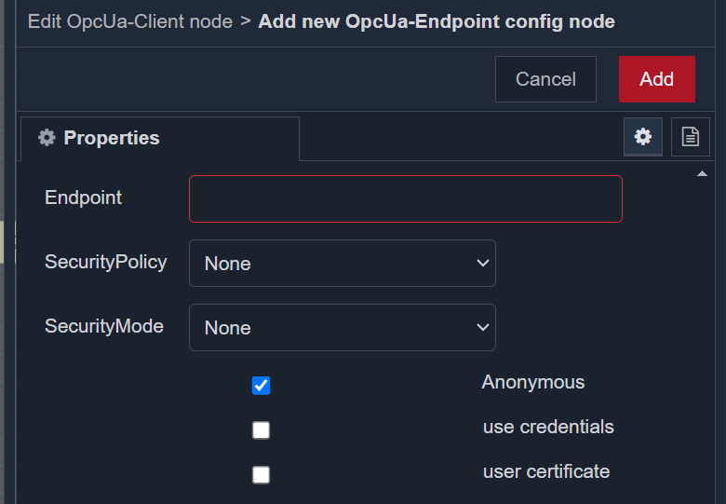
Endpoint setup
OPC UA endpoint: opc.tcp://N-NB108284:4334/UA/myFactory

Slide 7
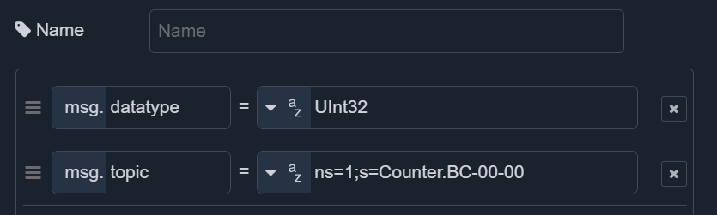

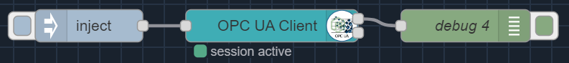
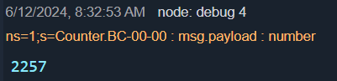

Slide 8
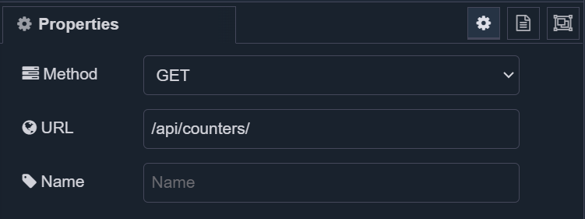

HTTP GET Method

Slide 9
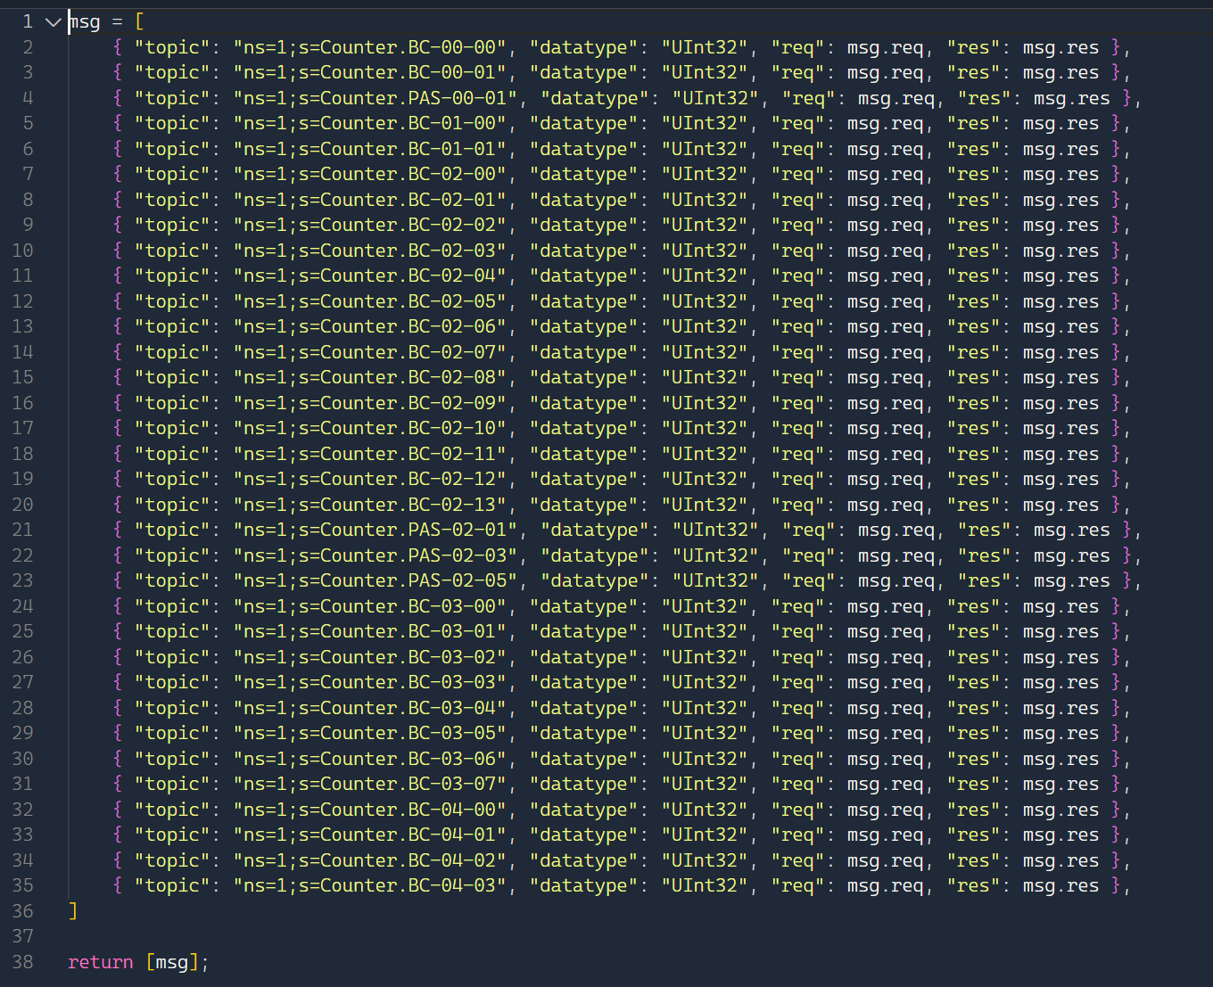
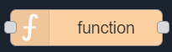
Notes:
msg = [
{ "topic": "ns=1;s=Counter.BC-00-00", "datatype": "UInt32", "req": msg.req, "res": msg.res },
{ "topic": "ns=1;s=Counter.BC-00-01", "datatype": "UInt32", "req": msg.req, "res": msg.res },
{ "topic": "ns=1;s=Counter.PAS-00-01", "datatype": "UInt32", "req": msg.req, "res": msg.res },
{ "topic": "ns=1;s=Counter.BC-01-00", "datatype": "UInt32", "req": msg.req, "res": msg.res },
{ "topic": "ns=1;s=Counter.BC-01-01", "datatype": "UInt32", "req": msg.req, "res": msg.res },
{ "topic": "ns=1;s=Counter.BC-02-00", "datatype": "UInt32", "req": msg.req, "res": msg.res },
{ "topic": "ns=1;s=Counter.BC-02-01", "datatype": "UInt32", "req": msg.req, "res": msg.res },
{ "topic": "ns=1;s=Counter.BC-02-02", "datatype": "UInt32", "req": msg.req, "res": msg.res },
{ "topic": "ns=1;s=Counter.BC-02-03", "datatype": "UInt32", "req": msg.req, "res": msg.res },
{ "topic": "ns=1;s=Counter.BC-02-04", "datatype": "UInt32", "req": msg.req, "res": msg.res },
{ "topic": "ns=1;s=Counter.BC-02-05", "datatype": "UInt32", "req": msg.req, "res": msg.res },
{ "topic": "ns=1;s=Counter.BC-02-06", "datatype": "UInt32", "req": msg.req, "res": msg.res },
{ "topic": "ns=1;s=Counter.BC-02-07", "datatype": "UInt32", "req": msg.req, "res": msg.res },
{ "topic": "ns=1;s=Counter.BC-02-08", "datatype": "UInt32", "req": msg.req, "res": msg.res },
{ "topic": "ns=1;s=Counter.BC-02-09", "datatype": "UInt32", "req": msg.req, "res": msg.res },
{ "topic": "ns=1;s=Counter.BC-02-10", "datatype": "UInt32", "req": msg.req, "res": msg.res },
{ "topic": "ns=1;s=Counter.BC-02-11", "datatype": "UInt32", "req": msg.req, "res": msg.res },
{ "topic": "ns=1;s=Counter.BC-02-12", "datatype": "UInt32", "req": msg.req, "res": msg.res },
{ "topic": "ns=1;s=Counter.BC-02-13", "datatype": "UInt32", "req": msg.req, "res": msg.res },
{ "topic": "ns=1;s=Counter.PAS-02-01", "datatype": "UInt32", "req": msg.req, "res": msg.res },
{ "topic": "ns=1;s=Counter.PAS-02-03", "datatype": "UInt32", "req": msg.req, "res": msg.res },
{ "topic": "ns=1;s=Counter.PAS-02-05", "datatype": "UInt32", "req": msg.req, "res": msg.res },
{ "topic": "ns=1;s=Counter.BC-03-00", "datatype": "UInt32", "req": msg.req, "res": msg.res },
{ "topic": "ns=1;s=Counter.BC-03-01", "datatype": "UInt32", "req": msg.req, "res": msg.res },
{ "topic": "ns=1;s=Counter.BC-03-02", "datatype": "UInt32", "req": msg.req, "res": msg.res },
{ "topic": "ns=1;s=Counter.BC-03-03", "datatype": "UInt32", "req": msg.req, "res": msg.res },
{ "topic": "ns=1;s=Counter.BC-03-04", "datatype": "UInt32", "req": msg.req, "res": msg.res },
{ "topic": "ns=1;s=Counter.BC-03-05", "datatype": "UInt32", "req": msg.req, "res": msg.res },
{ "topic": "ns=1;s=Counter.BC-03-06", "datatype": "UInt32", "req": msg.req, "res": msg.res },
{ "topic": "ns=1;s=Counter.BC-03-07", "datatype": "UInt32", "req": msg.req, "res": msg.res },
{ "topic": "ns=1;s=Counter.BC-04-00", "datatype": "UInt32", "req": msg.req, "res": msg.res },
{ "topic": "ns=1;s=Counter.BC-04-01", "datatype": "UInt32", "req": msg.req, "res": msg.res },
{ "topic": "ns=1;s=Counter.BC-04-02", "datatype": "UInt32", "req": msg.req, "res": msg.res },
{ "topic": "ns=1;s=Counter.BC-04-03", "datatype": "UInt32", "req": msg.req, "res": msg.res },
]
return [msg];
De return [msg]; zorgt ervoor dat de array element per element als bericht verstuurd wordt

Slide 10
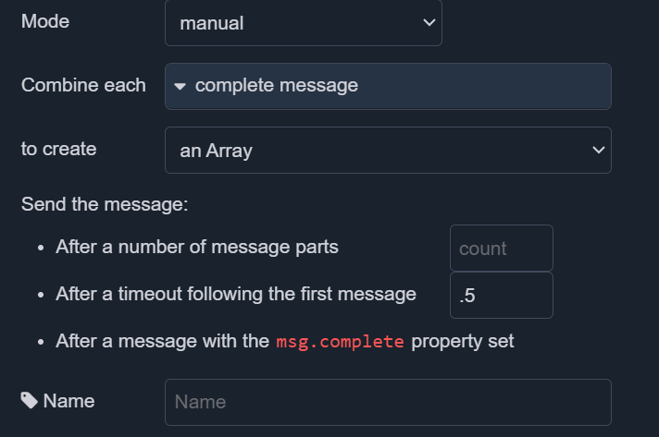

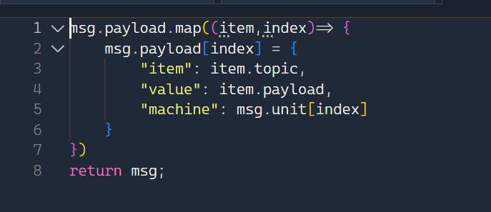
Parsing data
Notes:
Map neemt de msg.payload array en itereert over elk individueel object

Slide 11
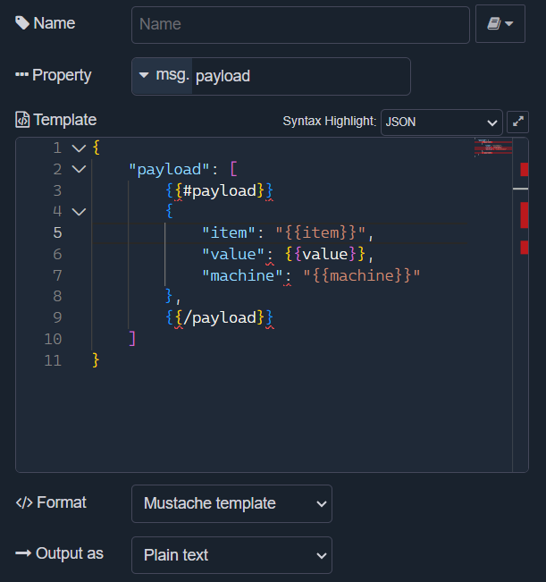

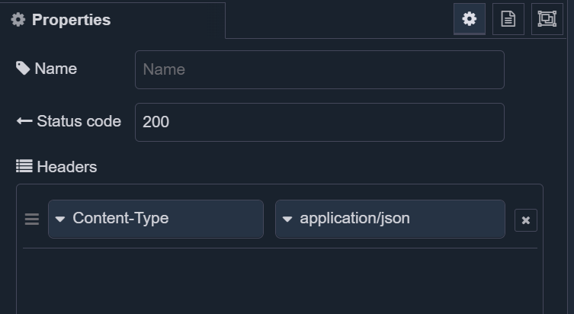
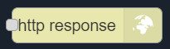
Response

Slide 12
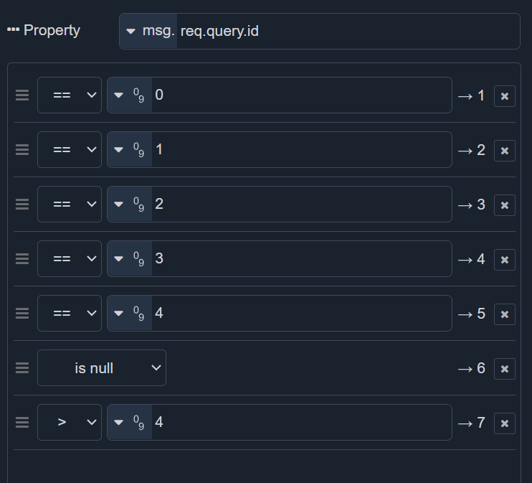

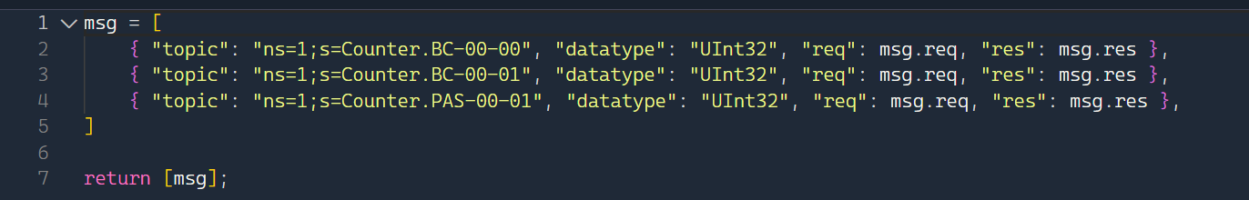
ID filter

Slide 13

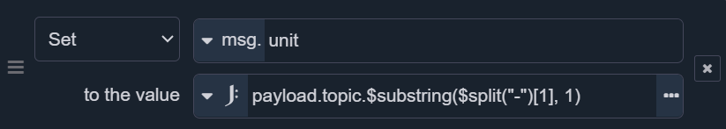
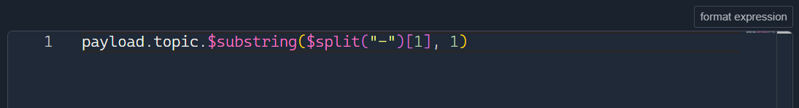
Setting the Unit
Notes:
In het payload.topic element split de tekst op elk “-” karakter, neem van deze array het tweede element ([0] is het eerste element) Zoek in dit element de substring die start vanaf het 2de karakter (geeft als uitkomst 0, 1, 2, 3 of 4 naargelang de unit)

Slide 14
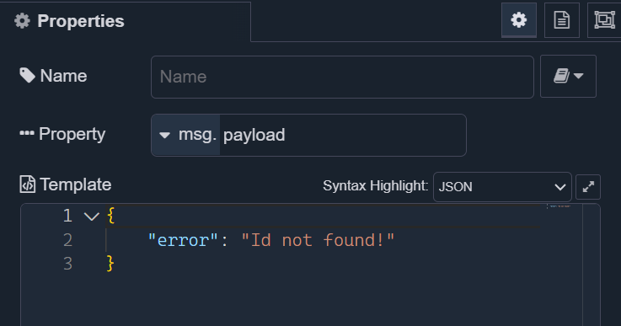
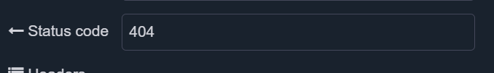
Wrong ID Handler

Slide 15
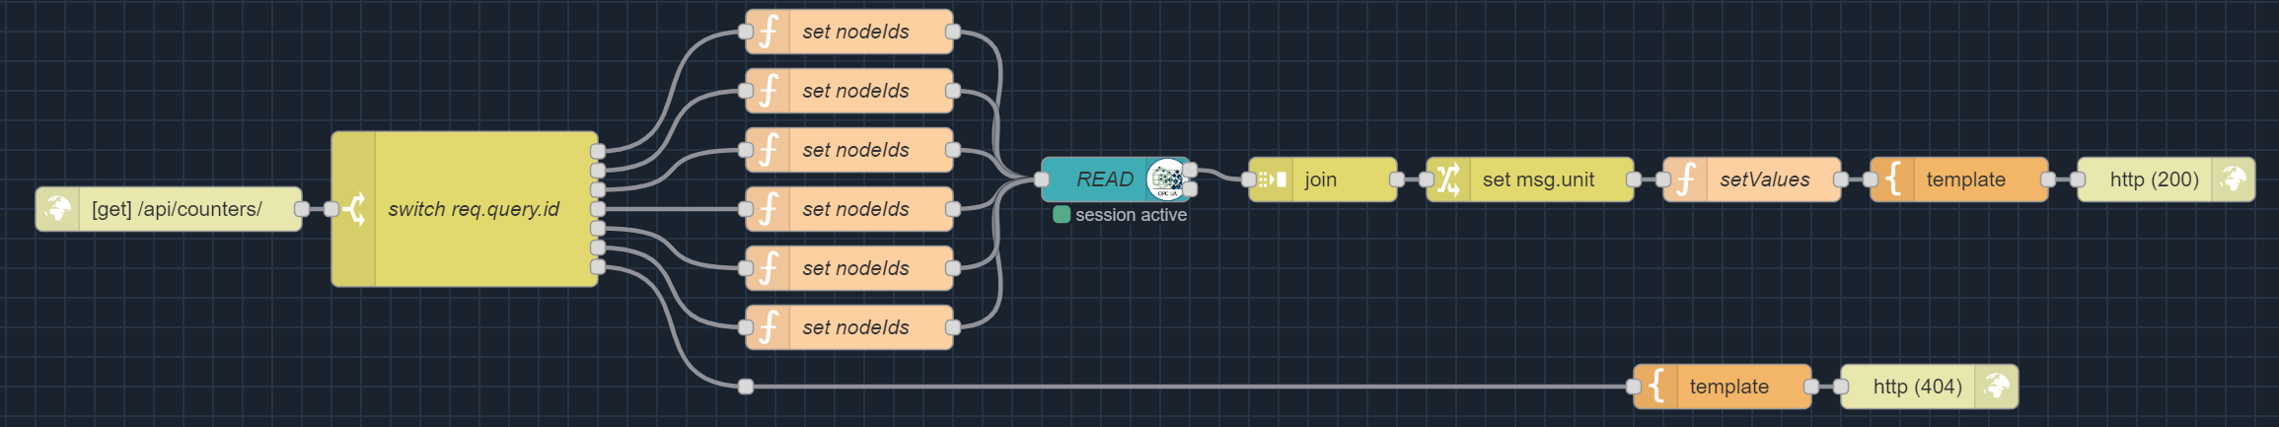
Full request

Slide 16
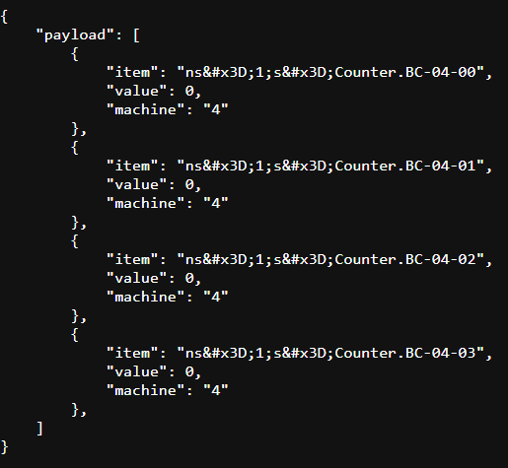
/api/counters?id=4

Slide 17
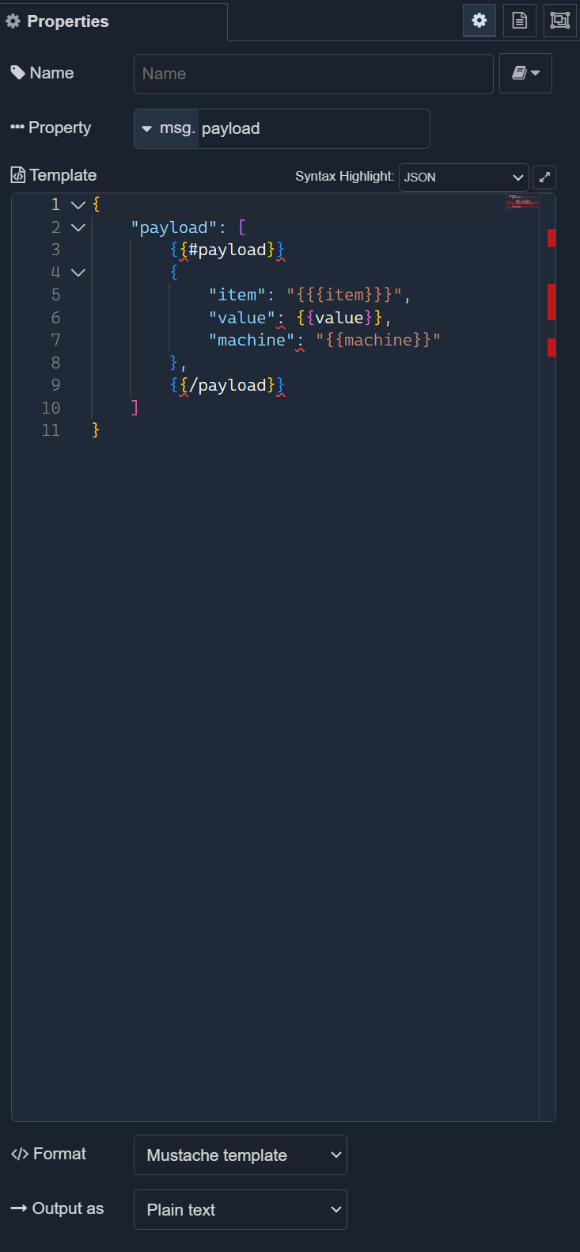
Character escaping

Slide 18
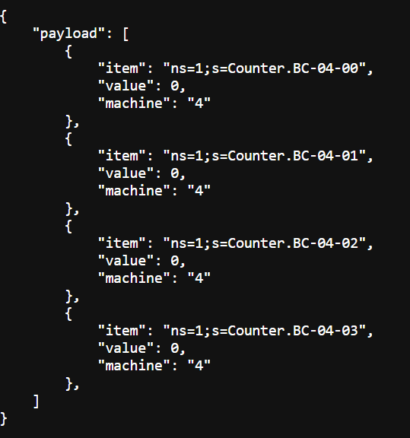
Correct /api/counters?id=4

Slide 19
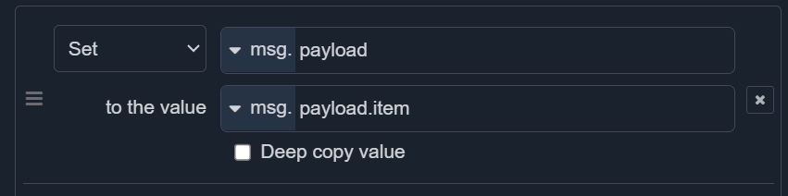
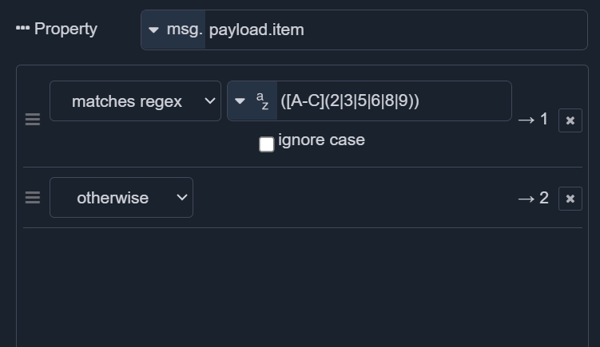
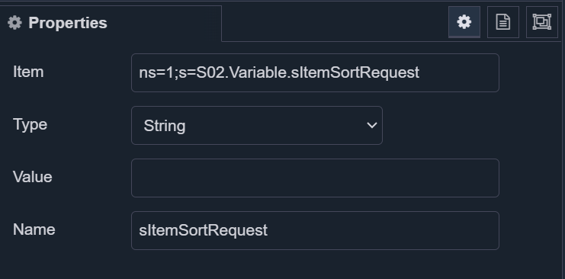
POST
Notes:
([A-C](2|3|5|6|8|9))

Slide 20
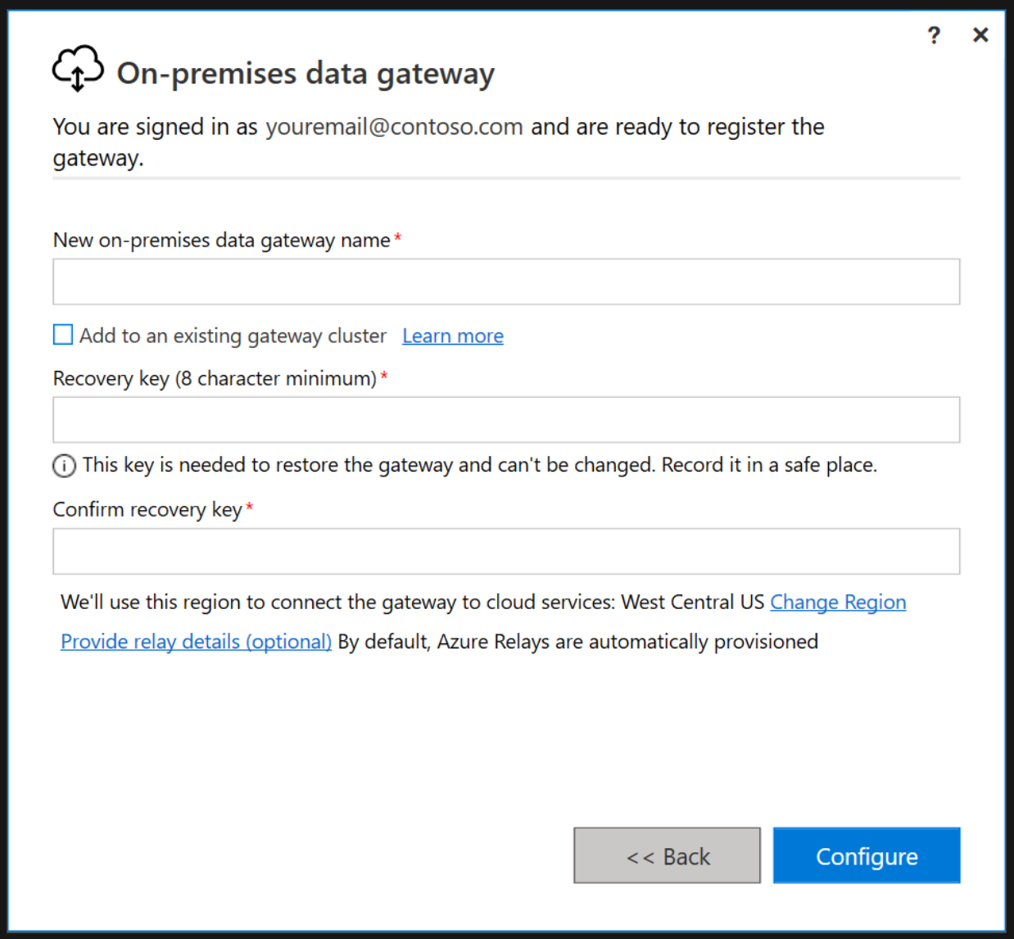
On-premises Data Gateway

Slide 21
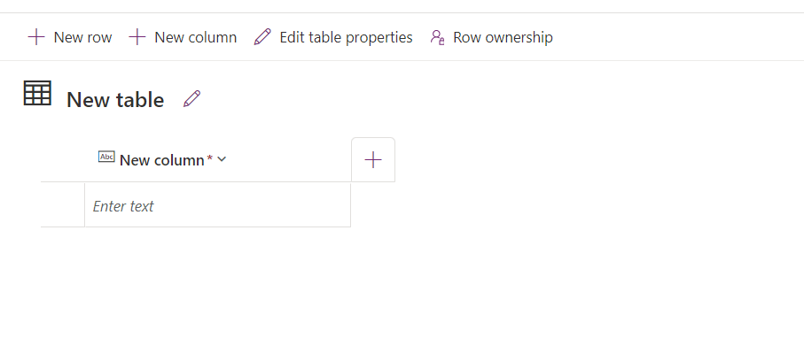
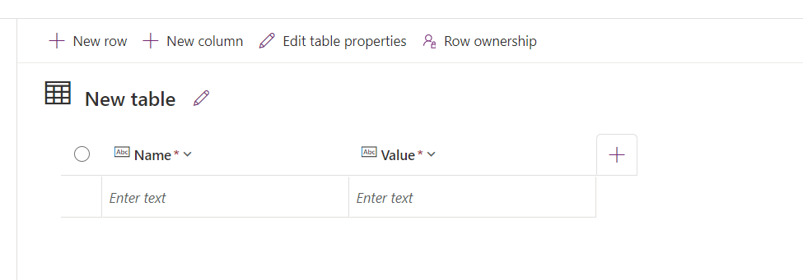
Creating POST-able values
Notes:
SHOW Request Items AND Request Location

Slide 22
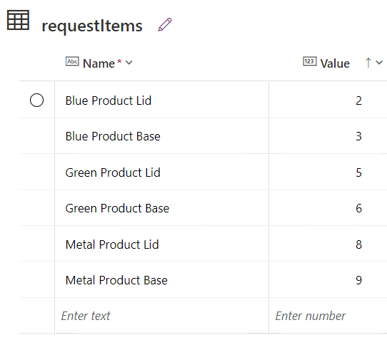
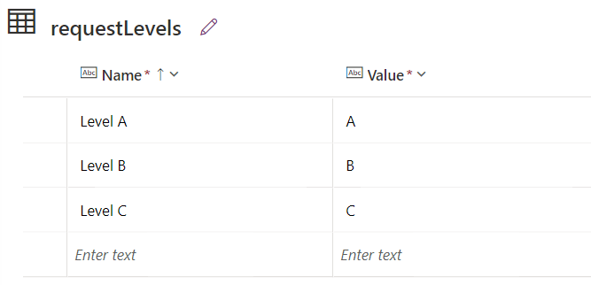
Creating POST-able values
Notes:
SHOW Request Items AND Request Location

Slide 23
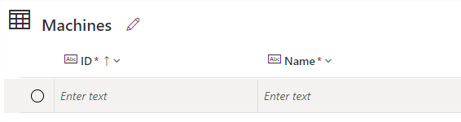
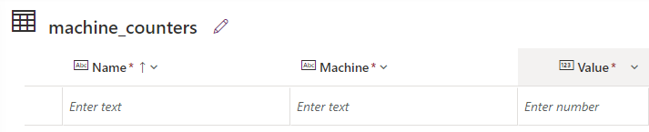
Creating usable tables

Slide 24
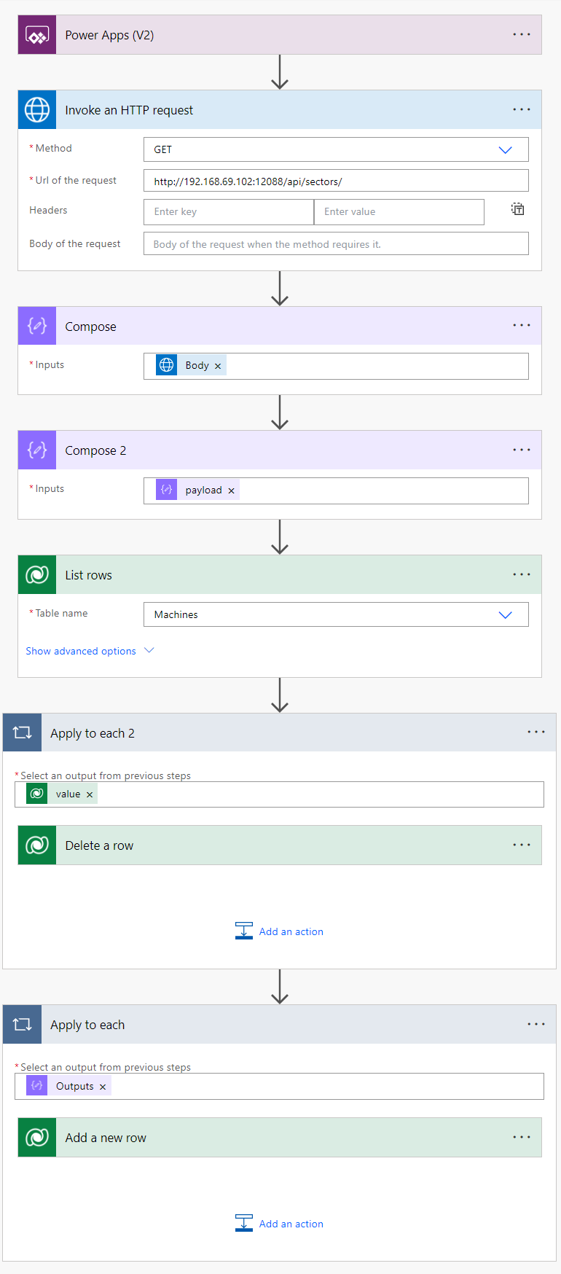
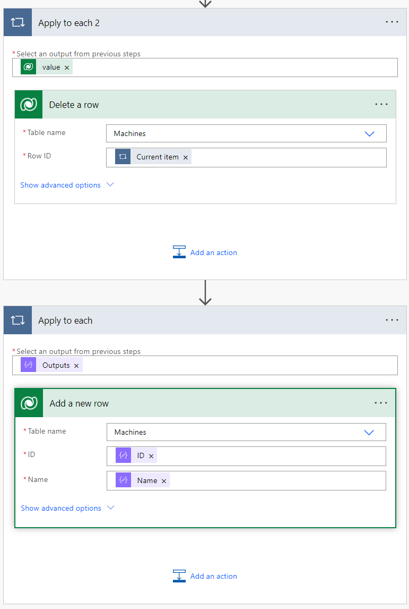
GET Sectors
Notes:
ID = items(‘Apply_to_each’)?[‘ID’]
Name = items(‘Apply_to_each’)?[‘Name’]

Slide 25
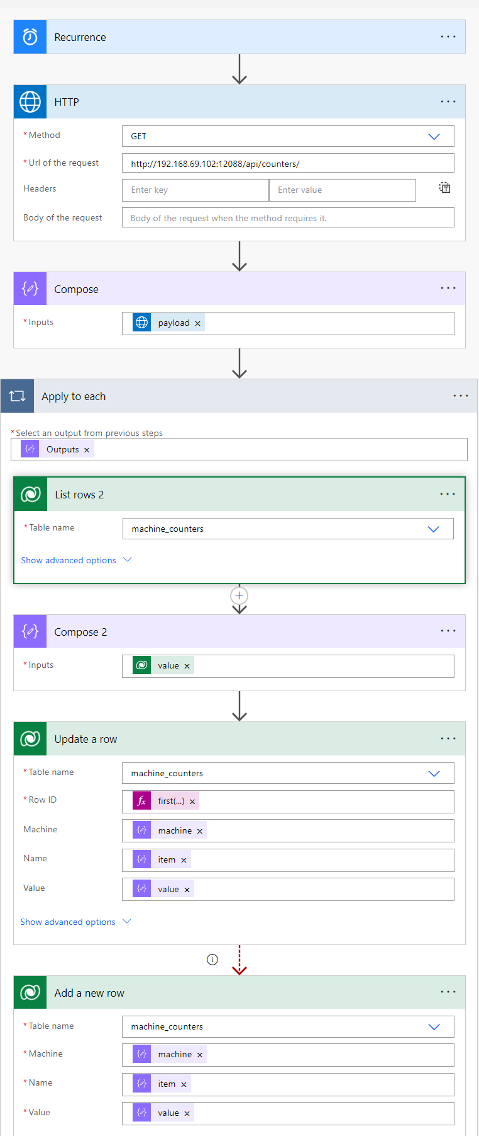
GET Counters
Configure run after
Update a row has failed
Notes:
Row ID: first(outputs('Compose_2'))?['cr844_machine_counterid’]
Machine: items(‘Apply_to_each’)?[‘machine’]
Name: items(‘Apply_to_each’)?[‘item’]
Value: items(‘Apply_to_each’)?[‘value’]

Slide 26
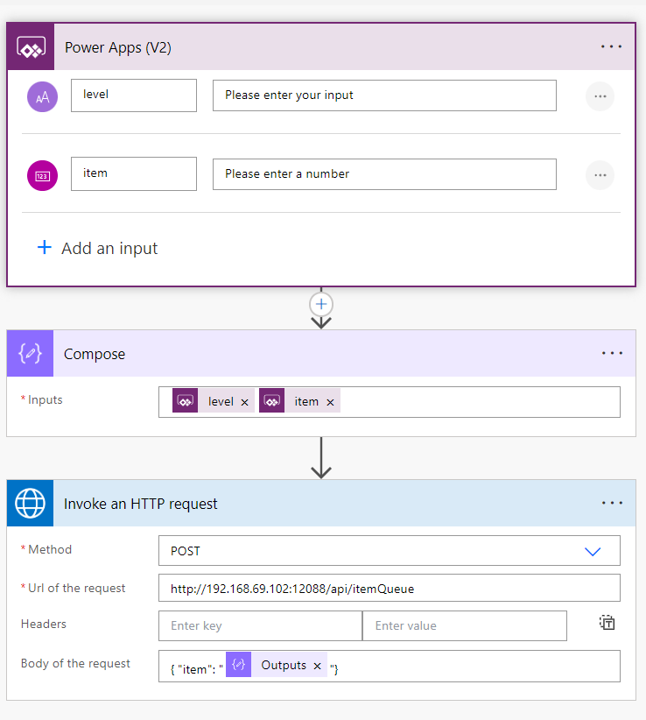
POST Data

Slide 27
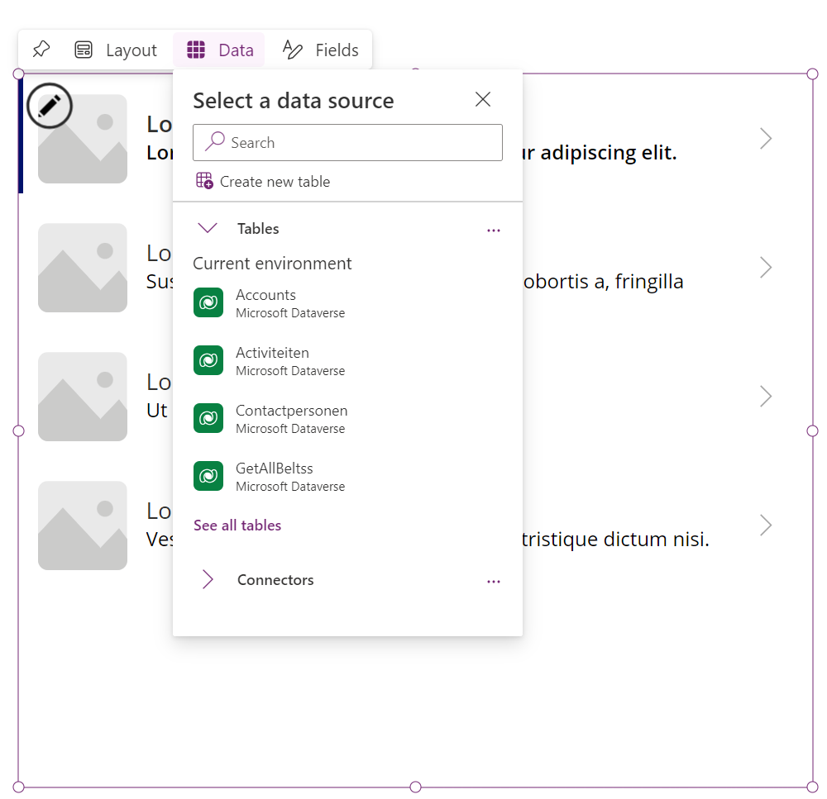
Vertical Gallery

Slide 28
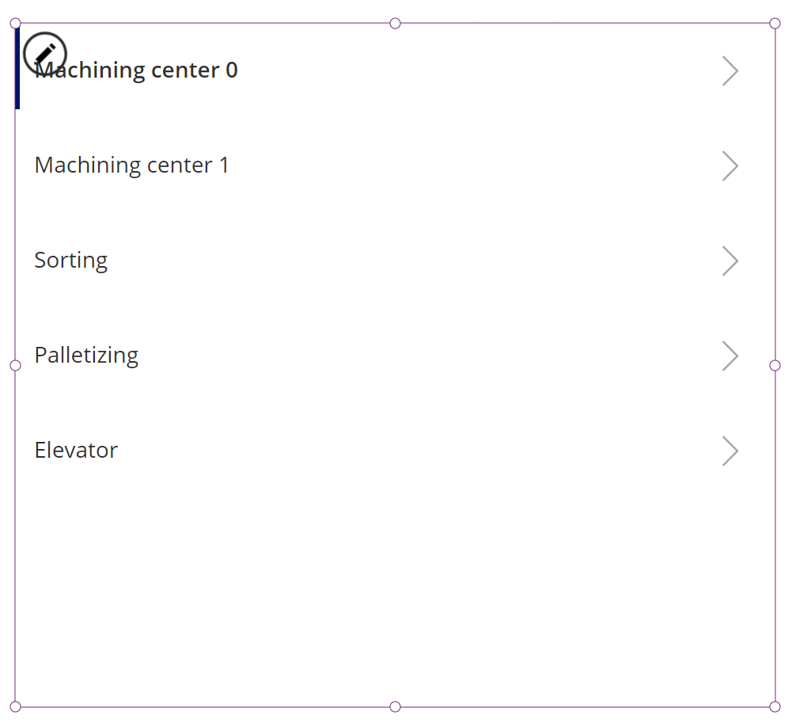
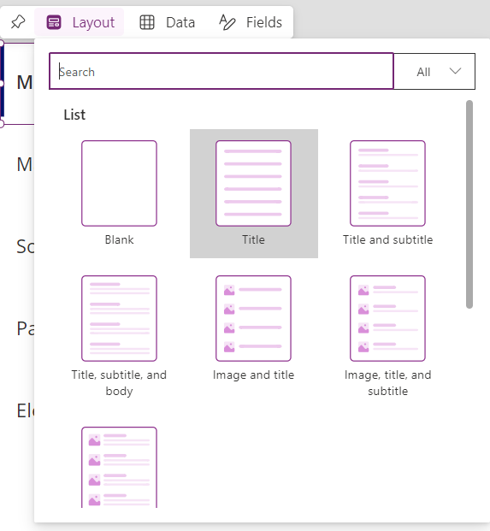
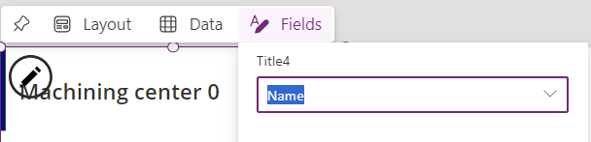

Slide 29
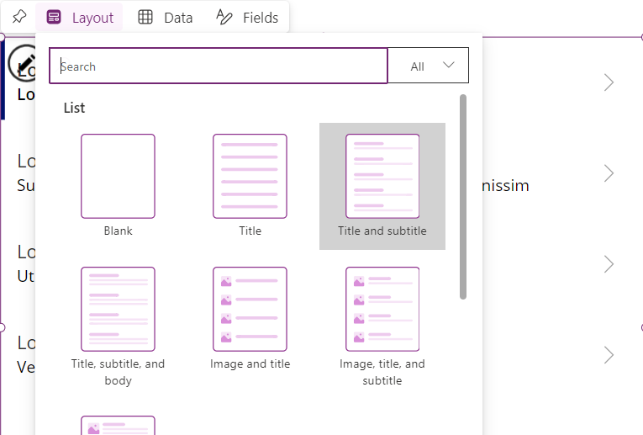
List in List
Notes:
Filter(machine_counters, Machine = Gallery1.Selected.ID)

Slide 30
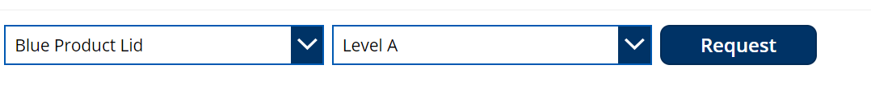
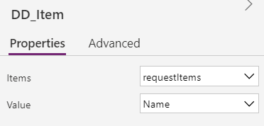
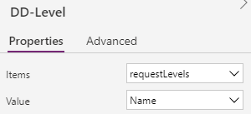
POST
Notes:
PostItem.Run(DD_Level.Selected.Value, DD_Item.Selected.Value)

Slide 31
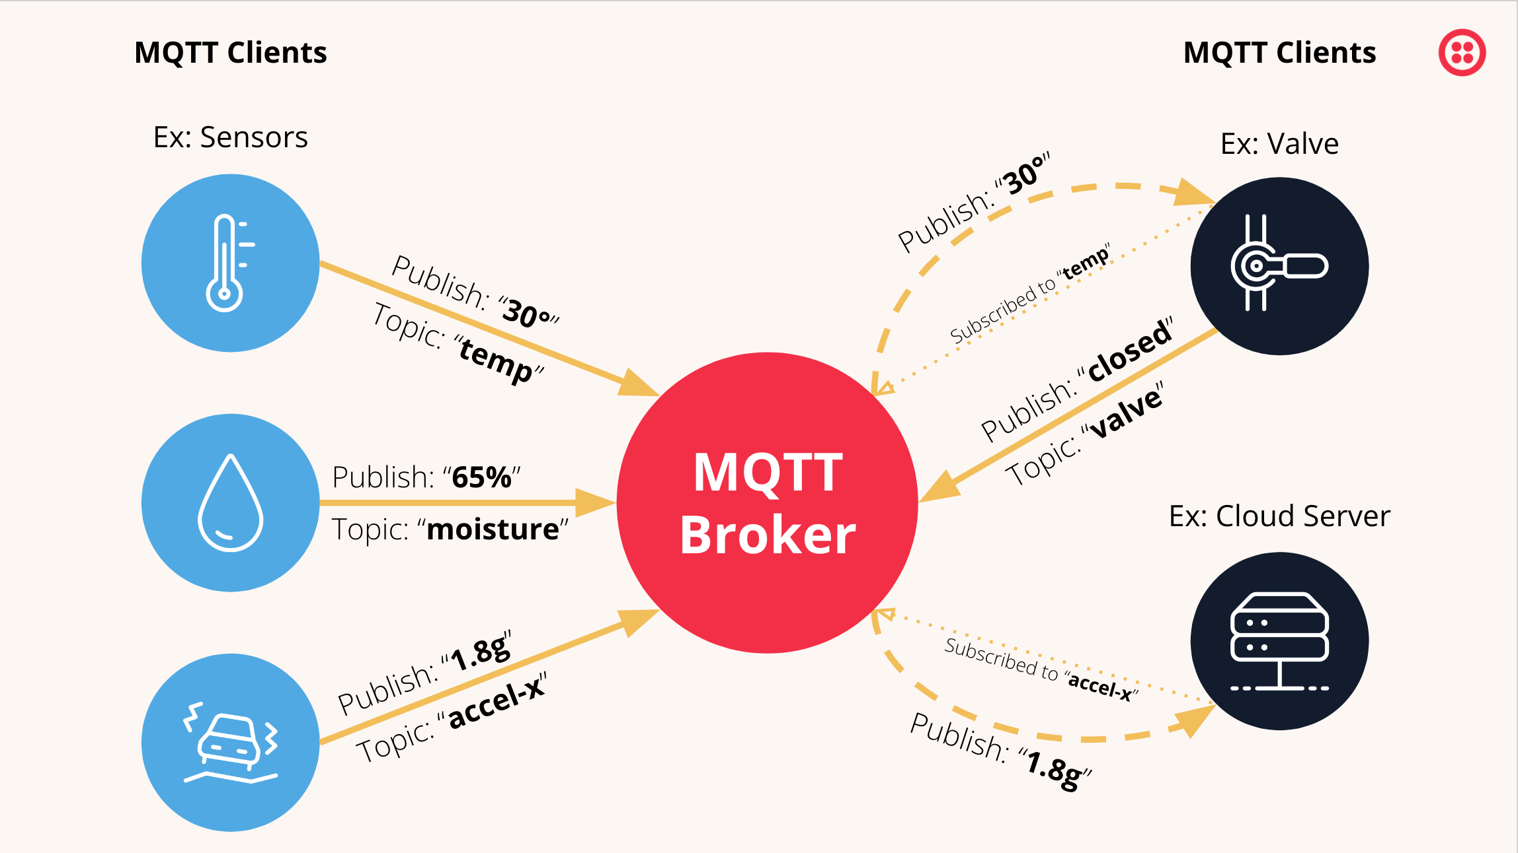
MQTT

Slide 32
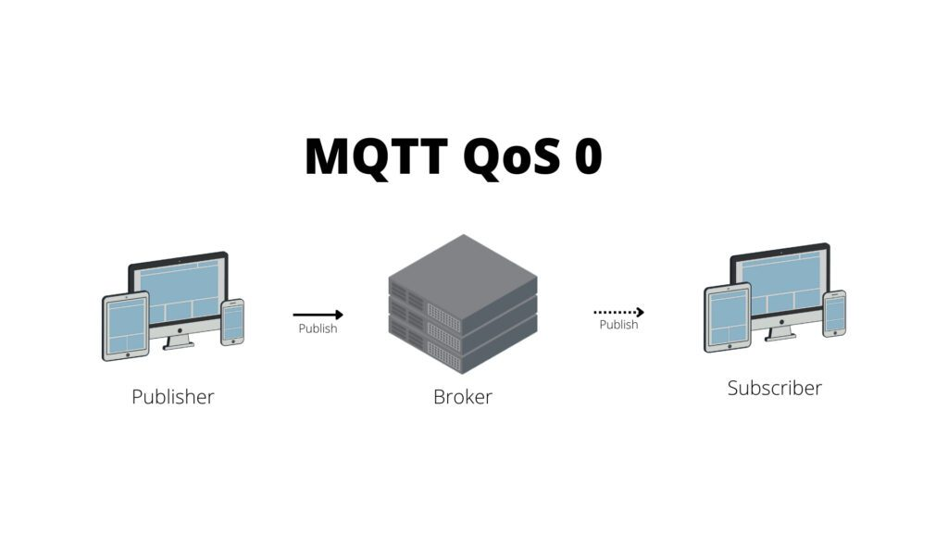


MQTT QoS
Best effort
At least once
Only once

Slide 33

MQTT Security
Standaard als leesbare tekst op het network
Gewoon te lezen met programma zoals Wireshark
Kies voor privaat netwerk
Indien op publiek netwerk (internet) → versleutelen

Slide 34


Dashboard
Grafische interface
Te bereiken in webbrowser via
http://IPADRES:1880/ui via netwerk (http://localhost:1880/ui)
Verbind bv je smartphone met Wifi netwerk

Slide 35

Installatie dashboard

Slide 36


Dashboard chart
Notes:
var msgtemp = { topic: "temperature", payload: msg.payload.temperature }
var msghum = { topic: "humidity", payload: msg.payload.humidity }
return [[msgtemp, msghum]];

Slide 37

Mysql + phpmyadmin
Localhost:8080
Host: mysql
User: root
Pw: password

Slide 38



Dashboard - Form node
Formulier met verschillende velden aanmaken
Data van ingevuld formulier wordt over verbinding verzonden
Data bekijken ahv debug node

Slide 39


Insert data in mysql uit form
Notes:
msg.payload = [new Date(), msg.payload.temperature1, msg.payload.temperature2, msg.payload.humidity];
msg.topic = "INSERT INTO TemperatureHumidity (time,temperature1,temperature2,humidity) VALUES (?,?,?,?);"
return msg;

Slide 40


Insert data in mysql uit mqtt
Notes:
msg.payload = [new Date(msg.payload.datetime), msg.payload.deviceid, msg.payload.temperature, msg.payload.humidity];
msg.topic = "INSERT INTO TemperatureHumidity (time,deviceid,temperature1,humidity) VALUES (?,?,?,?);"
return msg;

Slide 41


http get data from mysql
Notes:
msg.payload = [msg.payload.deviceid];
msg.topic = "SELECT time,temperature1 FROM TemperatureHumidity WHERE deviceid = ?;"
return msg;

Slide 42



Mysql to chart
Notes:
msg.payload = [msg.payload.deviceid];
msg.topic = "SELECT * FROM TemperatureHumidity WHERE deviceid = ? ORDER BY time DESC LIMIT 50;"
return msg;
(
$series := [
{ "field": "temperature1", "label": "temp" },
{ "field": "humidity", "label": "humidity" }
];
$xaxis := "time";
[
{
"series": $series.label,
"data": $series.[
(
$yaxis := $.field;
$$.payload.{
"x": $lookup($, $xaxis),
"y": $lookup($, $yaxis)
}
)
]
}
]
)

Slide 43

grafana
Localhost:3000
User:admin
Pw: admin
Datasource toevoegen
Dashboard maken

